Slide 1
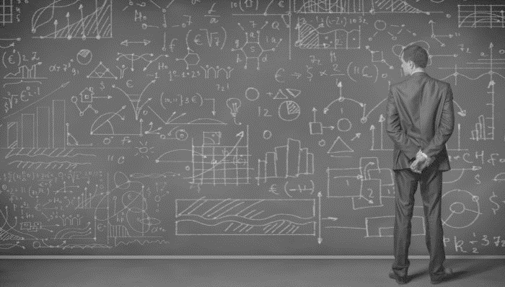
DATA SCIENCE
Class -11
Bagging and Boosting
Cross Validation

Slide 2
Ensembles
Combine multiple models (weak learners) to produce strong learners
Advantages
Leverage the strengths of different kind of models
Reduce overfitting
Very small or Very Large data can be handled well
Disadvantage
Speed and Explicability

Slide 3
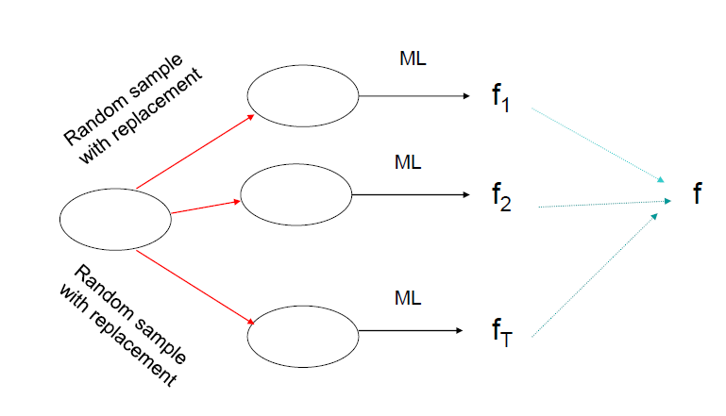
Bagging

Slide 4
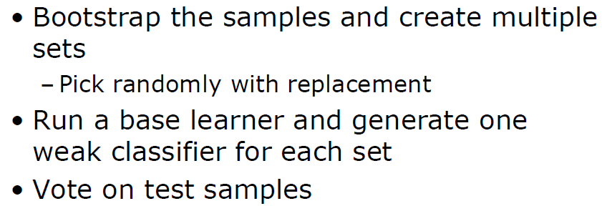
Bagging (Bootstrap Aggregating)

Slide 5
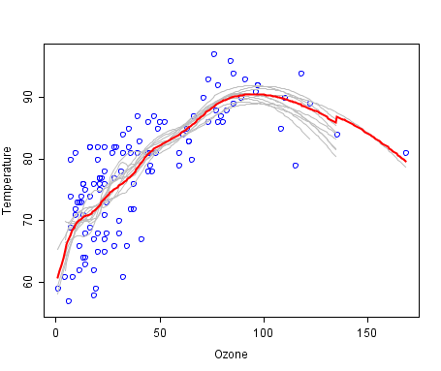
Bagging - Example

Slide 6
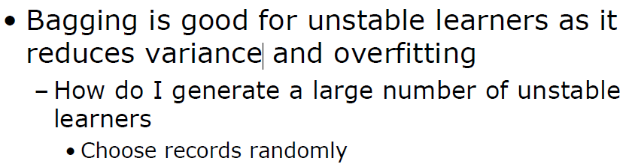
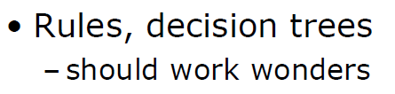
Bagging Contd…

Slide 7
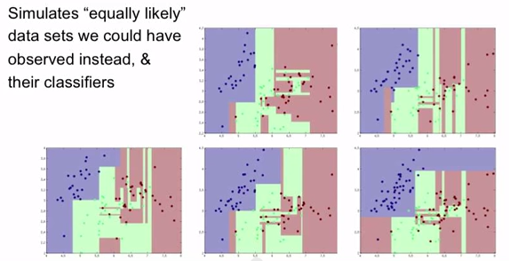
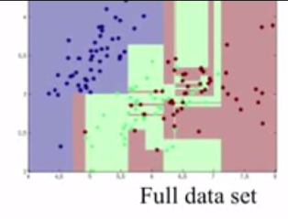
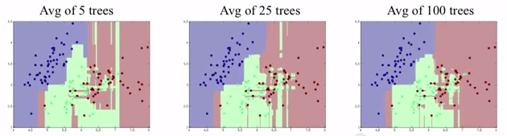
Bagging

Slide 8
A lot of data??
With a lot of data, we usually learn the same classifier most of the times. So how do we handle this?
How do we model when we have a lot of dimensions?

Slide 9
Random Forest
A variant of the Bagging concept

Slide 10
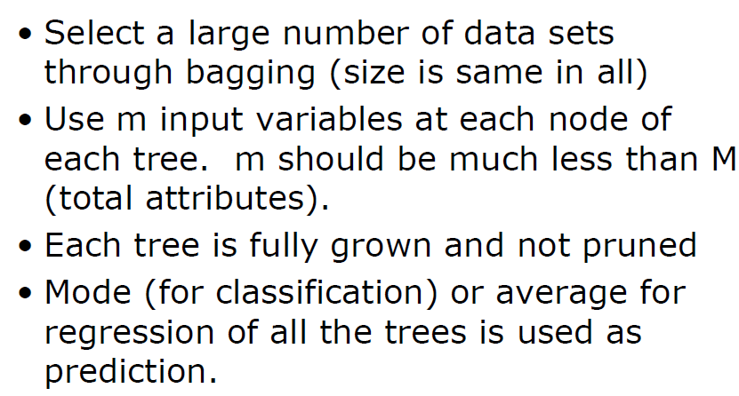
Random Forest

Slide 11
Random Forests
One of the best Machine Learning Algorithms
Regression and Classification problems can be solved
Right number of trees and right number of attributes to be used are to be selected

Slide 12
Random Forest - Imputation
TRAIN SET
If x(m,n) is a missing continuous value, estimate its fill as an average over the non-missing values of the mth variables weighted by the proximities between the nth case and the non-missing value case.
If it is a missing categorical variable, replace it by the most frequent non-missing value where frequency is weighted by proximity.
Now iterate-construct a forest again using these newly filled in values, find new fills and iterate again. Our experience is that 4-6 iterations are enough.
TEST SET
When there is a test set, there are two different methods of replacement depending on whether labels exist for the test set.
If they do, then the fills derived from the training set are used as replacements. If labels no not exist, then each case in the test set is replicated nclass times (nclass= number of classes). The first replicate of a case is assumed to be class 1 and the class one fills used to replace missing values. The 2nd replicate is assumed class 2 and the class 2 fills used on it.
This augmented test set is run down the tree. In each set of replicates, the one receiving the most votes determines the class of the original case.
Source: http://www.stat.berkeley.edu/~breiman/RandomForests/cc_home.htm#missing1

Slide 13
Boosting

Slide 14
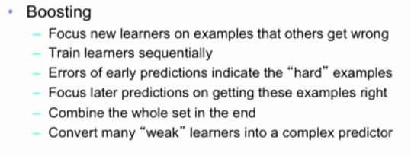
Boosting

Slide 15
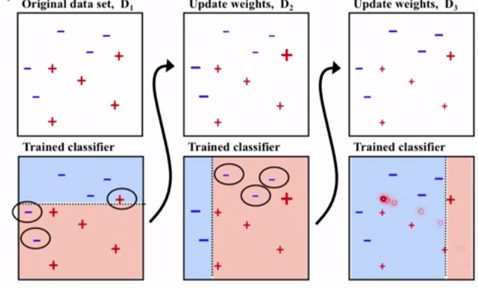
Ada- Boost

Slide 16
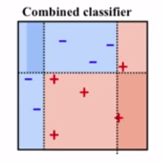
Ada-Boost

Slide 17
Gradient Boosting Machines

Slide 18
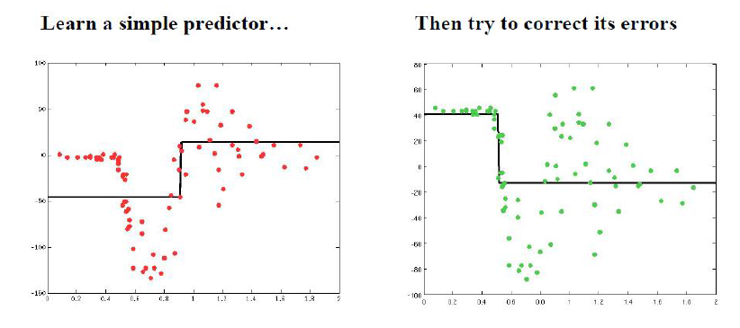
Gradient Boosting Machines

Slide 19
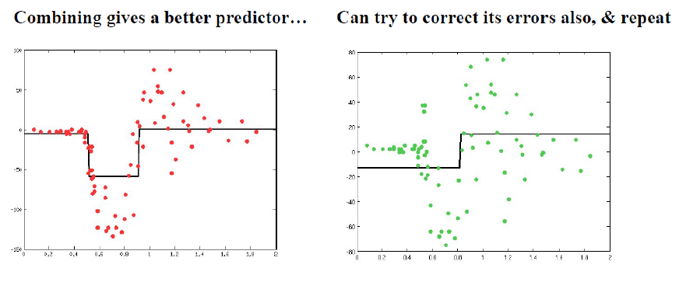
Gradient Boosting Machines

Slide 20
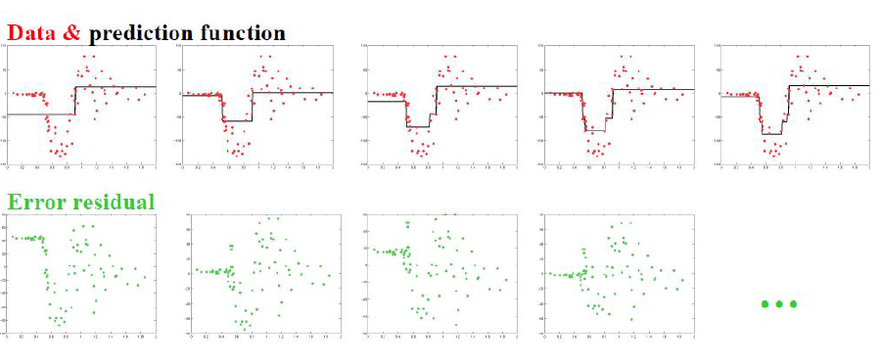
Gradient Boosting Machines

Slide 21
Gradient Boosting Machines
PersonID | Age | LikesGardening | PlaysVideoGames | LikesHats
1 | 13 | FALSE | TRUE | TRUE
2 | 14 | FALSE | TRUE | FALSE
3 | 15 | FALSE | TRUE | FALSE
4 | 25 | TRUE | TRUE | TRUE
5 | 35 | FALSE | TRUE | TRUE
6 | 49 | TRUE | FALSE | FALSE
7 | 68 | TRUE | TRUE | TRUE
8 | 71 | TRUE | FALSE | FALSE
9 | 73 | TRUE | FALSE | TRUE
Source : http://blog.kaggle.com/2017/01/23/a-kaggle-master-explains-gradient-boosting/

Slide 22
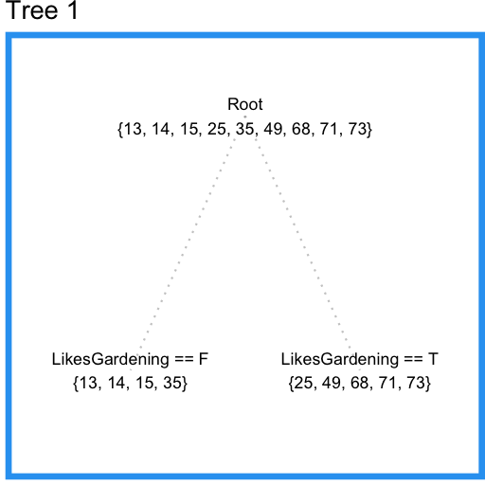
Gradient Boosting Machines
PersonID | Age | LikesGardening | PlaysVideoGames | LikesHats
1 | 13 | FALSE | TRUE | TRUE
2 | 14 | FALSE | TRUE | FALSE
3 | 15 | FALSE | TRUE | FALSE
4 | 25 | TRUE | TRUE | TRUE
5 | 35 | FALSE | TRUE | TRUE
6 | 49 | TRUE | FALSE | FALSE
7 | 68 | TRUE | TRUE | TRUE
8 | 71 | TRUE | FALSE | FALSE
9 | 73 | TRUE | FALSE | TRUE
Source : http://blog.kaggle.com/2017/01/23/a-kaggle-master-explains-gradient-boosting/

Slide 23
Gradient Boosting Machines
PersonID | Age | Tree1 Prediction | Tree1 Residual
1 | 13 | 19.25 | -6.25
2 | 14 | 19.25 | -5.25
3 | 15 | 19.25 | -4.25
4 | 25 | 57.2 | -32.2
5 | 35 | 19.25 | 15.75
6 | 49 | 57.2 | -8.2
7 | 68 | 57.2 | 10.8
8 | 71 | 57.2 | 13.8
9 | 73 | 57.2 | 15.8
Now we can fit a second regression tree to the residuals of the first tree.
Source : http://blog.kaggle.com/2017/01/23/a-kaggle-master-explains-gradient-boosting/

Slide 24
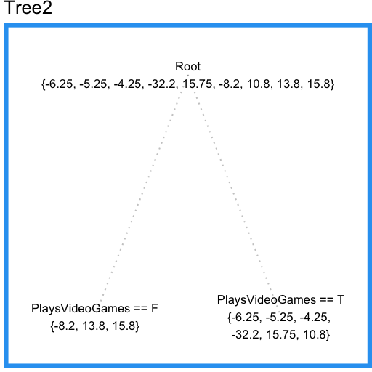
Gradient Boosting Machines
PersonID | Age | Tree1 Prediction | Tree1 Residual
1 | 13 | 19.25 | -6.25
2 | 14 | 19.25 | -5.25
3 | 15 | 19.25 | -4.25
4 | 25 | 57.2 | -32.2
5 | 35 | 19.25 | 15.75
6 | 49 | 57.2 | -8.2
7 | 68 | 57.2 | 10.8
8 | 71 | 57.2 | 13.8
9 | 73 | 57.2 | 15.8
Now we can improve the predictions from our first tree by adding the “error-correcting” predictions from this tree.
Source : http://blog.kaggle.com/2017/01/23/a-kaggle-master-explains-gradient-boosting/

Slide 25
Gradient Boosting Machines
PersonID | Age | Tree1 Prediction | Tree1 Residual | Tree2 Prediction | Combined Prediction | Final Residual
1 | 13 | 19.25 | -6.25 | -3.567 | 15.68 | 2.683
2 | 14 | 19.25 | -5.25 | -3.567 | 15.68 | 1.683
3 | 15 | 19.25 | -4.25 | -3.567 | 15.68 | 0.6833
4 | 25 | 57.2 | -32.2 | -3.567 | 53.63 | 28.63
5 | 35 | 19.25 | 15.75 | -3.567 | 15.68 | -19.32
6 | 49 | 57.2 | -8.2 | 7.133 | 64.33 | 15.33
7 | 68 | 57.2 | 10.8 | -3.567 | 53.63 | -14.37
8 | 71 | 57.2 | 13.8 | 7.133 | 64.33 | -6.667
9 | 73 | 57.2 | 15.8 | 7.133 | 64.33 | -8.667
Tree1 SSE | Combined SSE
1994 | 1765
Source : http://blog.kaggle.com/2017/01/23/a-kaggle-master-explains-gradient-boosting/

Slide 26
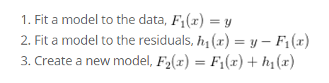
GBM – Contd.

Slide 27
Why ‘Gradient’ Boosting Machine ?
GBM makes use of Gradient Descent Algorithm at every step to find the best tree to be used to minimize the loss function
Loss functions used in GBM for Regression are …
Squared Loss or MSE
Absolute Loss

Slide 28
Why ‘Gradient’ Boosting Machine ? Contd…
GBM makes use of Gradient Descent Algorithm at every step to find the best tree to be used to minimize the loss function
What about Classification?
The only change will be to use a differentiable loss function such as
Log Loss or Softmax
Huber Loss etc…

Slide 29


Slide 30

Let’s

